Slide 1

Life is Best
for those who want to Live it,
Life is Difficult
for those who want to Analyze it,
Life is Worst
for those who want to Criticize it.
Our Attitude Defines Life.
Laugh so Hard,
that even Sorrow Smiles at You,
Live Life so Well,
that even Death Loves to see you Alive… enjoy Your Life…!

Slide 2

Train
the
Trainer
Presented by
Your Name

Slide 3

“OH GOD, GRANT ME,
THE SERENITY TO ACCEPT
THE THINGS THAT I CANNOT CHANGE,
THE COURAGE TO CHANGE
THE THINGS THAT I CAN
AND
THE WISDOM TO UNDERSTAND
THE DIFFERENCE BETWEEN THE TWO.”

Slide 4
Share the lessons we have Learned
Why we Tell Stories
Notes:
Why We Tell Stories
There was once a disciple of a great teacher. Day after day the disciple would sit at the feet of his teacher listening to his instruction. Many people would come to visit and inevitably the teacher would engage them by telling a story.
One day the disciple asked; "Guruji, why do you engage people by means of stories? Why don't you just give them your teaching straight out?"
The guru answered: "Bring me some water."
Now the disciple knew his teacher to be a very formal and disciplined man. He had never asked for water at this time of the day. Nevertheless, he went immediately to fetch it. Taking a clean brass water pot from the ashram kitchen, the disciple went to the well, filled the pot with water and returned. He offered it to his teacher.
"Why have you brought me a pot when I asked only for water?"
The moral of this story…
We share with others the lessons we have learned. We provide you with a banquet of various tastes and styles. It is up to you to choose that dish which you find most palatable.

Slide 5
Objectives
To understand and develop the necessary traits and skills to be a Effective Trainer
To develop classroom and online training skills

Slide 6
Life Blood of the Trainer
3 E's
Notes:
Energy
Enthusiasm
Excitement

Slide 7
ATTITUDE
LEARN
KNOWLEDGE
SKILLS
Notes:
ASK questions to learn and to help others learns
Knowledge = What
Skills=How
Attitude=Want

Slide 8
The Challenge
Notes:
Ice Breaker to know each other – the ball game

Slide 9

Let explore the Good and Bad Trainer
Notes:
Invite brainstorming inputs from the audience or
In teams let them come out with points

Slide 10
Steps in Developing & Conducting Training
Analyzing the requirement
Developing the objectives
Outlining the content
Developing a plan
Conducting the learning experience
Facilitation skills

Slide 11
Analyzing the Learning Requirement
Why is this learning required?
What is the overall goal of the training/teaching?
Who are the learners?
What content is required?
What are the timing issues?
Where will the training be conducted?

Slide 12

Know your AUDIENCE
Analysis - Who are they? How many will be there?
Understanding - What is their knowledge of the subject?
Demographics - What is their age, sex, educational background?
Interest - Why are YOU PRESENTING it?
Environment - Logistics – Place – Venue - Infrastructure?
Needs - What are their needs, objectives?
Customized - “WHAT IS IN IT FOR ME?”
Expectations - What do they expect to learn or hear from you
Notes:
Ex: Gynac doctor going for a talk to nuns about infertility and its cure… all nuns are working in the holy cross nursing maternity hospital.
Danfoss: I had been to Chennai and was talking in Hindi and nobody laughed at my silliest of jokes.
If there are Managers = talk profits, productivity, bottomline, technical people = talk indept study, integration of x and y, research shows..
Needs = how to save 2 hrs, how to release stress, increase productivity, enhance skills.

Slide 13
Developing the Learning Objectives
What do the learners need to be able to do:
In class? For research? On the job? In other situations?
What do they need to know in order to do those tasks?

Slide 14
Outlining the Content
What content is necessary for the learning objective?
What content may be extraneous to the objective and can be left out?
What resources can be provided for further learning?

Slide 15
Developing a Plan
What teaching methods and training aids are most appropriate for the
learners and the content?
How can the topics be outlined for clarity and flow?
What is the best timing for each topic?

Slide 16
Confucius…!
I HEAR AND I FORGET
I SEE AND I REMEMBER
I DO AND I UNDERSTAND

Slide 17
Identify the Learning Style of the Learners
Kinesthetic Learners
Doing
Style
Observing and Imitating
Style
Listening and
Reading
Style
Visual
Learners
Auditory Learners

Slide 18
Conducting the Learning Experience
What facilitation skills can be used to manage the process?
Evaluation of the learning experience
What info do I need regarding the success of the learning experience?
When and how shall I gather it?

Slide 19

Facilitation Skills
Communication Skills
Articulation Skills
Presentation Skills
Questioning & Answer Skills
Interpersonal Skills

Slide 20

1. Communication Skills

Slide 21
Communication is all about Connecting
Speaking(30%) | Listening & Observing (45%)
Reading (16%) | Writing (9%)
A Trainer needs to Connect with the Audience

Slide 22
"I hit him in the eye yesterday."
ONLY I hit him in the eye yesterday. (No one else did.)
I ONLY hit him in the eye yesterday. (Did not slap him.)
I hit ONLY him in the eye yesterday. (I did not hit others.)
I hit him ONLY in the eye yesterday. (I did not hit outside the eye.)
I hit him in ONLY the eye yesterday. (Not other organs.)
I hit him in the ONLY eye yesterday. (He doesn't have another eye.)
I hit him in the eye ONLY yesterday. (Not today.)
I hit him in the eye yesterday ONLY. (Did not wait for today.)
Notes:
Activity – What does the sentence mean to you.. Ask participants to think and answer.

Slide 23
While Communication a Trainer needs to take care of:
Verbal – 7%
  All about Words & Language
Vocal – 38%
  Tone, Pitch, Volume, Accent
Visual – 55%
  Body Language

Slide 24
Evaluate the Barriers a Trainer is Exposed to
Speaking | Listening-Observing | Body Language
1 2 3 4 5 | 1 2 3 4 5 | 1 2 3 4 5

Slide 25
The Communication Process
Source
Encoding
Channel
Decoding
Receiver
Feedback

Slide 26
Check you Communication Skills as a Trainer
As a Speaker
As a Listener
As an Observer
As an Evaluator

Slide 27

2. Articulation Skills

Slide 28
Articulation Skills of a Trainer
Content Structuring Skills
Message Delivery Skills
Handling Others
Clarifying Skills
Please rate yourself in the following areas using the scale.
5 – Always, 4 – Frequently, 3 – Occasionally, 2 – Rarely, 1 – Never
Please focus on ‘what you really do’, and NOT ‘what you think you should be doing’

Slide 29
Content Structuring Skills
1. I am able to identify all relevant points
2. I take some time to collect my thoughts before I open my mouth
3. I can diagnose what content is missing
4. I am able to prioritize all topics/data based on time available
5. I am able to structure my sentences around the central theme/idea
6. I am able to accurately estimate the total time required by me
7. I make a sincere effort to keep things as simple and non-technical as possible while talking to a layman.

Slide 30
Message Delivery Skills
1. I always ‘Set the Context’ before I begin. (explain the purpose, background, etc.)
2. I am consciously aware of the drawbacks of all media (telephone, email, internet etc.)
3. For important situations, I rehearse the delivery beforehand.
4. I organize all my thoughts in a specific order; I maintain that order during delivery.
5. I never get carried away, even while explaining something passionately.
6. I pause at regular intervals to let my words ‘sink in’.
7. I can supplement my ‘words’ with the appropriate ‘non-verbal cues’.

Slide 31
Skills related to ‘Handling Others’
1. I am aware of my ‘audience’; I know what their expectations are.
2. I encourage others to ask questions while I speak.
3. I request my ‘listeners’ to share their thoughts and feelings periodically.
4. I am able to read ‘verbal cues’ displayed by others.
5. I am able to read ‘non-verbal cues’ displayed by others.
6. I can remain calm and objective, even if I have a huge personal stake in the issue being discussed
7. I always maintain eye-contact, even with people I dislike.

Slide 32
Clarifying Skills
I encourage others to ask questions while I speak.
1. When I speak, it is my duty to confirm whether the listener has understood accurately. (Ask Feedback)
2. When others speak, I usually confirm my understanding of what I have heard. (Give Feedback)
3. If I don’t agree with somebody, I tend to ask questions that clarify rather than challenge.
4. Whenever I have a doubt, I ask (that moment) or I record my doubt in writing.

Slide 33

3. Presentation Skills

Slide 34

Stage Fright?
Nervousness
Stomach ~@%^
Jitters
Fear
Palpitation
Anxiety
Mind Blank

Slide 35

How will I Develop Confidence?
KNOWLEDGE
EXPERIENCE
Why
Plan
What
Prepare
When
Practice
Where
Practice
Who
Practice
How
Present

Slide 36

How Should I do it?
Prepare
Plan
Practice
Present
Physically
Mentally
Logistically

Slide 37

Before the Presentation
Desire
Plan
Prepare
Practice
Relax

Slide 38
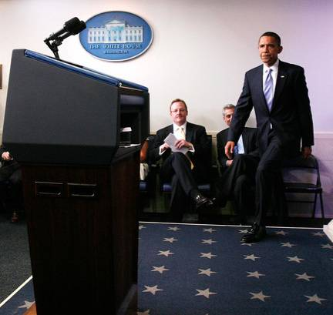
5 Basic Platform Manners
Gravity
Terminus
Smile
Eye contact
Gestures
Notes:
REMEMBER YOU ARE ON STAGE FROM THE VERY BEGINNING TO THE VERY END.
Look around the audience and fix on one person for a short time – maybe a second – and then move on. Show them that you are trying to include them all.
Be careful with your hands and look out for repeated mannerisms that can annoy dreadfully.
Example of an amateur play. One male character was always fiddling with the small change in his pocket to the extent that one felt it was something important in the play. It wasn’t, it was just a nervous habit that spoilt things.
You want them to concentrate on what you are saying and not on what you are doing with your hands.

Slide 39


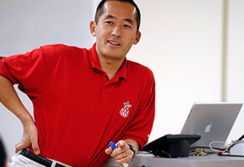



Gravity - Lost

Slide 40
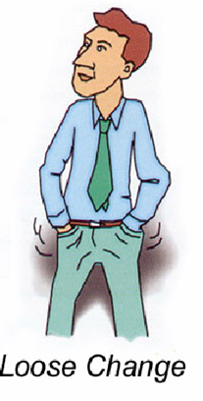
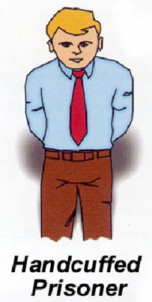
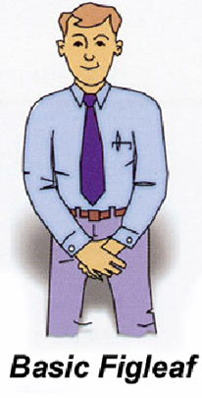
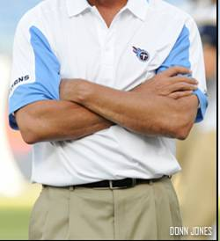
Wrong Terminus

Slide 41
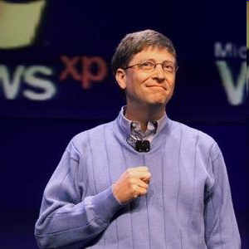
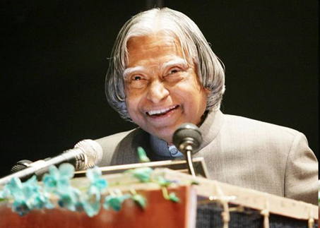
Smile

Slide 42
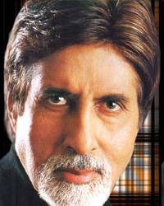
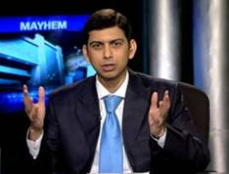
Eye-Contact

Slide 43
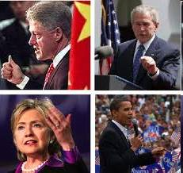

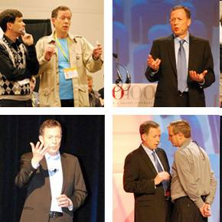

Gestures

Slide 44

4. Questions and Answering Skills

Slide 45

Fielding Questions
Now the terror begins
Anticipate questions (FAQ’s)
Acknowledge the person & question
Repeat / Restate Questions
Defer specific questions until after talk
Be patient with stupid questions
?

Slide 46

The Q & A Strategy
Listen Attentively
Limit one person at a time
Don’t allow the lime-light or the platform to be taken away from you
Never cut off, or ridicule or be defensive
Never leave an issue hanging

Slide 47

Providing Answers
Keep Answers short
Ask for clarification or example for vague question
Avoid debates
Acknowledge alternative views
Invite the audience to answer
It’s OK to say “I don’t know.”

Slide 48

5. Interpersonal Skills

Slide 49
Interpersonal Skills
Think before you speak
Understand the other person’s point of view
Take in criticism with a pinch of salt
Honestly own your mistakes
Stop pointing fingers at others
Take out time to diffuse tensions
Work out a compromise
Don’t give up easily

Slide 50
Skills needed to Learn Classroom v/s Online
Classroom
Listening comprehension
Ability to pay attention for long spans of time
Colleague collaboration / Teamwork
Oral expression/ Ability to put thoughts into words
Online
Reading skills
Self-pacing and time management
Independent study skills
Self motivation and discipline
A learning space created by user
Notes:
Online Learning Takes Special Skills
What skills are needed to successfully learn from online training?
Are there some users that will never be successful using eLearning?
Are the skills needed to learn in a classroom environment different from skills needed online?
Now the argument can be made that a lot of these skills apply to both classroom and online training. However it seems that certain skills seem more important for certain delivery methods.
As more and more courses move online we need to be more thoughtful of our design.
We need to realize that some users might not be great readers, have a lot of self-discipline, and/or have time management skills.
So how can we improve? What can we do to help out our learners?
Ideas to help learners that struggle in these areas:
Lack of Reading Skills
We’ve all heard that “a picture is worth a thousand words.” Images can really improve the learner’s comprehension and speed up the learning. This is true for all levels of readers.
Be sure to “chunk” text, use bullets, and make it “scannable“.
Use audio and instructional video.
Lack of Independent Study Skills
Add a forum or discussion area.
Put the learners into virtual groups and have them do some online training and then hold a team discussion over the phone/email.
Hold live WebEx sessions to connect with others.
Lack of Self-pacing and Time Management
Make the courses short. This helps learners be able to complete training even if they only have a few minutes to dedicate.
Indicate how long each module/lesson will take. This will allow learners to plan.
Lack of Motivation and Discipline
Make the course visually appealing and interactive. (scenarios, quizzes, games, etc.)
Content should be applicable to the learner’s job and interests.
Possibly have the learner agree to a training schedule and have “check-in” points where they must indicate their progress.
Lack of Learning Space
Tell learners what is expected. They should know that they need to find a quite place (free of distractions) before beginning the course.
Provide a list of tips to create a virtual learning environment. Maybe they could turn of their phone, close all other computer applications, shut the door, put a sign on the door, put earphone on instead of listening through the computer speakers, etc.

Slide 51
Challenges with Online Training
No Body Language
No Eye Contact
Language
Voice
Bandwidth
Transmission
People
Voice
Visuals
Tests
Quiz
Chat Interaction
Activity
Time
Notes:
Online training is starting to be a good supplement to classroom and elearning activities. The benefits are quite obvious - costs, the lower carbon footprint, the ability to actually do it without any huge constraints. We need to look beyond just those benefits though - we can have lots of people in the training, we can all talk together, we can walk out without offending people and most importantly, its an nice way to bring geographical diversity to your classroom. So it's a little more than just a virtual classroom.
That said, there's no opportunity for body language, eye-contact and then again there's a myriad of distractions available to us -- for example I'm live blogging at this moment.
It looks like everyone's been involved with online training in some way or the other. So let's hear some of Matt and Charles' tips for online training.
Technology
So, what you don't want is someone reading a script. What you don't want is someone reading script. What you do want is someone bringing in a bit of a personality. Voice is crucial to the success of an online training session. Using a headset helps and perhaps a directional mike maybe? Trainers need to be hugely expressive online - remember people can't see you; so make peace with that and do what you can to overcome that hurdle. As human as you can sound, the better for you!
Content
So let's see what kind of subjects work well in this medium.I've now completely lost visuals- damn! So I'll just go with what I hear.
Seems like soft skills are a good area to discuss online. Bringing in experts and to keep it short and simple is a good idea as well. Learning from suggestions that others make is a great way to influence behaviour. The more you can involve people, the better - 90% of the talking should be from the participants. Teach people how to use the tool and how to use the chat box. Just as Don does for the LSG webinars, it does helps a lot to get people used to the environment. This is the equivalent of getting people used to a training environment. Also, get people's views by using polls as an activity. This is the equivalent of how we do polls (show of hands) in a classroom.
Don't overdo the poll though, but beware the meaningless poll - they can break up the momentum of the session. So use polls where you expect a distinct set of answers, but if things are just obvious, don't just do it for the sake of doing it.
Final Tips
Ask people what they'll commit to do once they've been through the session.
What's going to stop them from doing what they'd like to do.
Discuss these hopes and concerns with participants.
Don't be ambitious - it's not about what you want to do to look cool. It's also about managing change and getting people comfortable with the medium.
Roland from Live Time has a tip - the technology is there, but don't go overboard!
The voice of just one person gets boring after a while, so vary it by bringing in audio, video, etc.
Don't get flustered if things go wrong - remembers Murphy's law.
Be flexible - something that works in one session, will not necessarily work in the next. The dynamics of people are extremely crucial to keep in mind.
Online training takes time. To make something, simple, short without the benefit of physical presence and the interactivity that people expect, is always tough. So try getting as much of this work done up front and make sure you prepare well!
Encourage Participation - ASK QUESTIONS! "does that make sense," "are we all on board," "does anyone have any questions," "do you think that's a good idea?"

Slide 52
5 Easy Tips for Teaching Online Courses
1. Don’t bombard your learners with material.
2. Talk with your learners instead of at them.
3. Manage your learner’s expectations.
4. Engage your learners whenever possible. Encourage Participation by asking questions
5. Provide constant feedback.
Notes:
5 Easy Tips for Teaching Online Courses
Technology has provided us with the ability to take an online course from anywhere. While this may make being a student easier, it doesn’t necessarily make it easier to be an instructor. Actually, in direct contrast it can make our jobs as trainers more difficult. However, the key to being an excellent online course instructor really comes down to five easy tips. As long as you can master these five things your online course success will either meet or exceed that of your face-to-face courses.
1. Don’t bombard your learners with material.
The number one problem that most online courses have is they aren’t broken down into manageable pieces. For example, one time I took an online course from my compliance department that was over 4 hours long. Yes, you heard me correctly… 4 hours. The first problem with this is obvious. As a friend of mine says, “one can only learn what the seat can bare.” Online courses should be no longer than 20 minutes. Any additional content should be broken out into another module and delivered to the learner on a separate occasion. This gives you an opportunity for reinforcement – which gets me to my second issue with bombardment. As learning professionals we know that a single learning intervention won’t drive the message home. You need to reinforce the material in order to make a behavior change. If you deliver (for example) four hours worth of content in one sitting you have to work very hard to get the learner to be willing to accept your attempts to reinforce the material. By breaking up the online course you make it easier to “sneak in” reinforcement and have learners who are more willing to pay attention to your lesson.
2. Talk with your learners instead of at them.
When leading an online course it is important to have a good deal of contact with your students. No, you don’t have to give them your home phone number, but they should hear from you at least every other day or two until they have completed each of the modules in the course. Many LMSs have a communication tool built in that will allow you to contact each of the learners at their online courses are sent out or as they are completed. If possible personalize the messages by dropping in a mail merge name field. Also, ask them to contact you directly if they have any questions. Even if you don’t think you can answer their questions assure them that you can find them somebody that will. A good rule of thumb for online course learner interaction is that the amount of time you spend communicating with the learners should equal to the amount of time you would have been in the classroom.
3. Manage your learner’s expectations.
Let your learners know from the beginning of the online course what you expect from them. Sometimes it is best to meet in person to have an “orientation” and then begin the online portion of the course. Other times you may want to make a 5-10 minute webcast that you can show and then be available for questions. What should you cover? Make sure your learners know that there will be more than one module and explain why this benefits them. If you plan to release an online module on Monday and issue a test on Thursday let them know that. If you have a FAQ that you want your learners to check before contacting you make sure you show them where it is located. The more your learners know up front, the less time you will spend troubleshooting problems later.
4. Engage your learners whenever possible.
Teaching an online course has benefits beyond what the classroom provides. Some of these benefits are in the form of the technologies you use. Use these technologies to engage your learners and make sure they play their part in creating the educational content too. Depending on the type of course you can ask your students to record and upload a video that explains their thoughts on a particular topic. Then ask other learners to comment on the submissions. Or, add a forum to the online course and ask your learners to discuss the topic with eachother.
5. Provide constant feedback.
Online courses can make learners feel very isolated. In addition to doing what I described in step #4, make sure to provide your learners with increased feedback. Since they can’t interact with you directly providing more feedback than you would in a face-to-face setting is incredibly important. This feedback should not just be via private email messages to your students, but if you employ the forum or message board approach you should also praise students that are making insightful comments. This not only gives that learner the confidence they need to use their new knowledge in the “real world,” but also shows the other learners what you are looking for.
Online courses can be very exciting and very rewarding, but you have to be prepared to handle the nuances. If you really want to learn how to teach an online course the best advice I can give you is to take one! Check out your local community college and take an online course in something that interests you. Pay attention to the way the course is run and write down what you like and don’t like. Then use this list to construct your own online courses.
Best,

Slide 53
Logistics for Online Training
There's Dim Dim, Live Meeting, Webex, GoToMeeting, Lotus Live Meetings, Cisco Webex and Adobe Connect.
Bandwidth
Storage
Risk
Integration
Costs
People
Notes:
As you may already know, there are several options for online training tools. There's DimDim, Live Meeting, Webex, GoToMeeting, Lotus Live Meetings, Cisco Webex and Adobe Connect. If you're still deciding, here are a few things to consider:
Bandwidth - does your organisation have enough bandwidth on the network to run this kind of thing?
Storage - where will you save most of your data, recordings, etc?
Risk - how secure is the service and how open or closed is the option you're using?
Integration - are you using it with your LMS or other systems?
Costs - how cheap or costly is your implementation going to be? How much staff time are you going to need?
People
People, as we've already discussed have a myriad of distractions in their life. People are people and if they want to multi-task, they will! When you don't get eye-contact, it's a gigantic difference. If you're multi-tasking then you're perhaps going to be a good online training that's because you already know what your audience will do.

Slide 54
Checklist - Trainers Guide
Establishing and maintaining your credibility as an instructor
Managing the learning environment effectively
Pace lessons appropriately to maximize information absorption
Demonstrating effective communication skills as a whole
Demonstrating effective presentation skills
Demonstrating effective questioning techniques
Responding to the students' needs for clarification and feedback in an appropriate manner
Providing motivation and positive reinforcement
Using appropriate instructional methods
Making effective use of all media
Evaluating the performance of the student
Evaluating the quality of your own delivery
Reporting evaluation information in an appropriate manner

Slide 55
Final Tips
Ask people for commitment
What's going to stop them to learn
Discuss these hopes and concerns with participants
Don't be ambitious
The technology is there, but don't go overboard!
Use Visuals, Video because voice gets boring
Remember Murphy's law
Be flexible
Online training takes time
Encourage Participation
Notes:
Ask people what they'll commit to do once they've been through the session.
What's going to stop them from doing what they'd like to do.
Discuss these hopes and concerns with participants.
Don't be ambitious - it's not about what you want to do to look cool. It's also about managing change and getting people comfortable with the medium.
The technology is there, but don't go overboard!
The voice of just one person gets boring after a while, so vary it by bringing in audio, video, etc.
Don't get flustered if things go wrong - remember Murphy's law.
Be flexible - something that works in one session, will not necessarily work in the next. The dynamics of people are extremely crucial to keep in mind.
Online training takes time. To make something, simple, short without the benefit of physical presence and the interactivity that people expect, is always tough. So try getting as much of this work done up front and make sure you prepare well!
Encourage Participation - ASK QUESTIONS! "does that make sense," "are we all on board," "does anyone have any questions," "do you think that's a good idea?"

Slide 56
Tips for Trainers Training Online
Prepare thoroughly for facilitation
1. Be familiar with the software, tools and technology
2. Be prepared to teach in the online medium
3. Know the content
4. Develop a “Plan B”
5. Get some experience as a learner
6. Plan, prepare, practice
7. Know your learners
B. Ensure an effective delivery
1. Get started on the right foot
2. Manage the main event: Content delivery
C. Pay attention to four special skills
1. Give and receive feedback
2. Be effective when correcting learners
3. Handle silence without fear
4. Deal with problems effectively and professionally
D. Do your follow-up

Slide 57
Contact

